Slide 1
Review of Genomic Risk Classification in Breast and Prostate Cancer
Richard Li MD

Slide 2
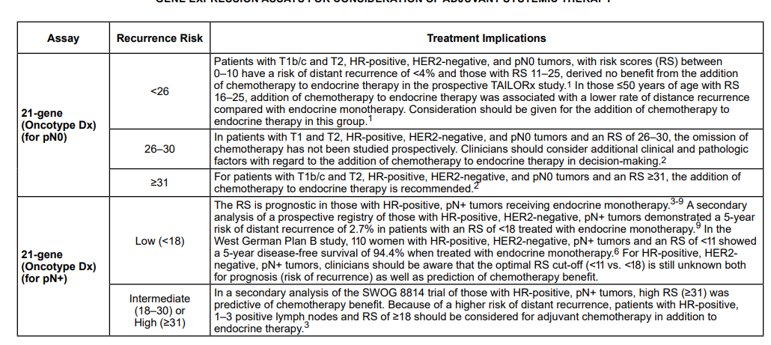

Slide 3
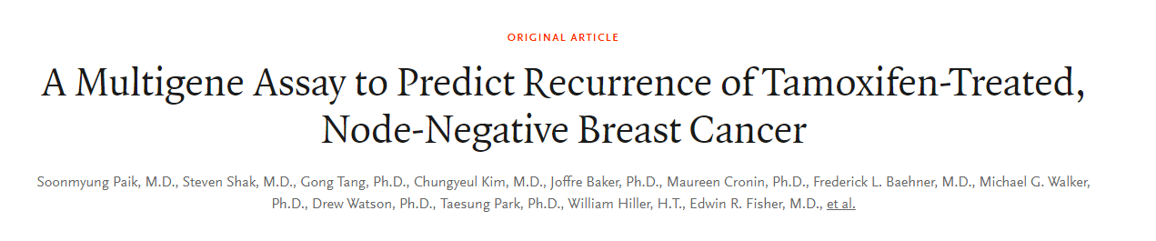
“real-time quantitative reverse transcription polymerase chain reaction (QRT-PCR) using RNA extracted from formalin-fixed paraffin-embedded tumor tissue (FPET) blocks”
Paik et al. NEJM 2004

Slide 4
Trials used as basis
NSABP B-14 (1987-1983):
pN0, ER+ randomized to placebo or tamoxifen x 5 years
NSABP B-20
pN0, ER+ randomized to tamoxifen vs M->5-FU vs CMF
Both in pre-Her2 era

Slide 5
Oncotype development
250 candidate genes identified from literature
3 independent clinical studies, total 447 patients
Identified 21 genes (5 reference)
Created a recurrence score model

Slide 6
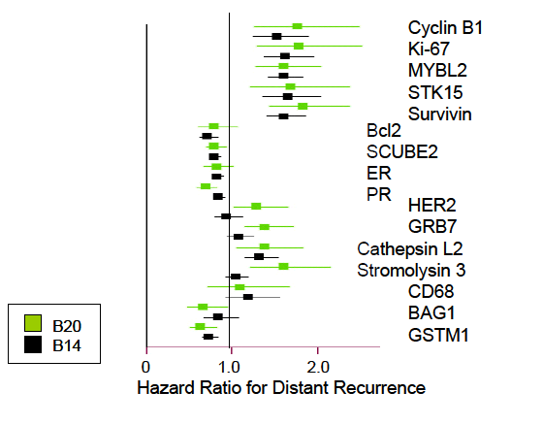

Slide 7
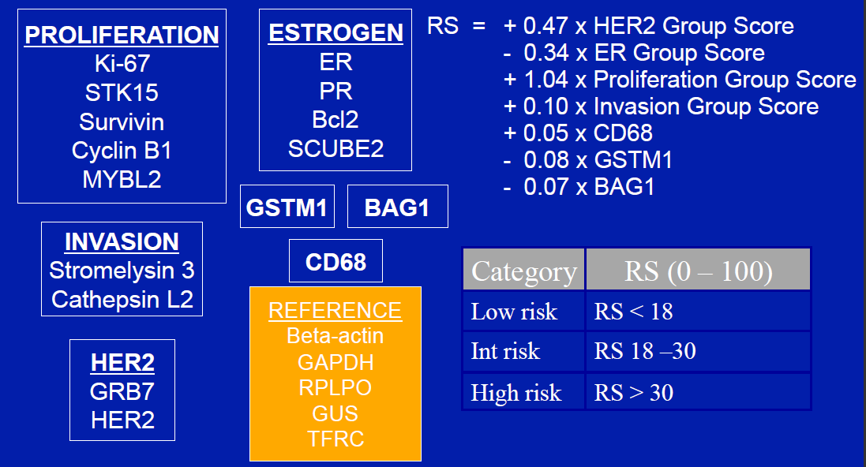

Slide 8
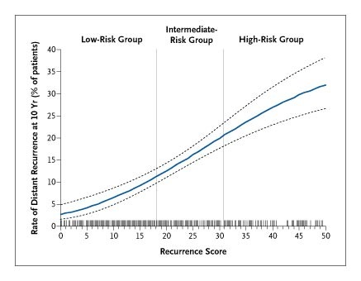
Low risk:
0-17
Int risk:
18-30 High risk:
31+

Slide 9
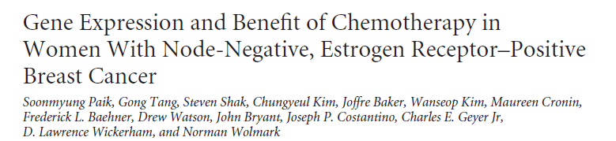
Studied 651 patients in NSABP B-20
Paik et al. JCO 2006

Slide 10
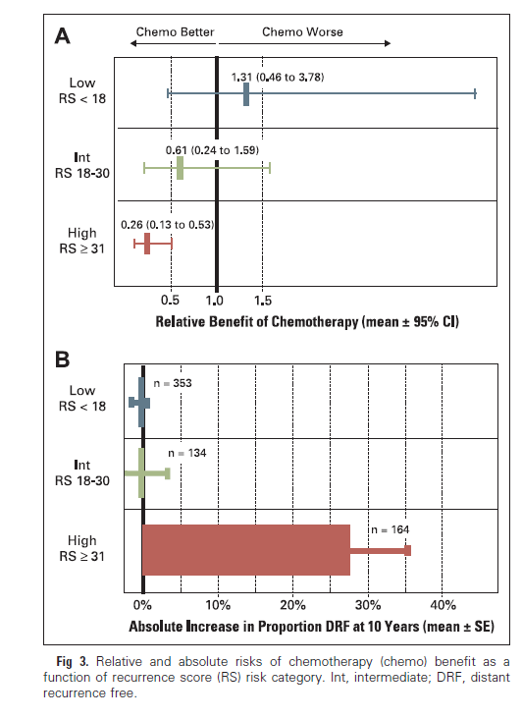

Slide 11
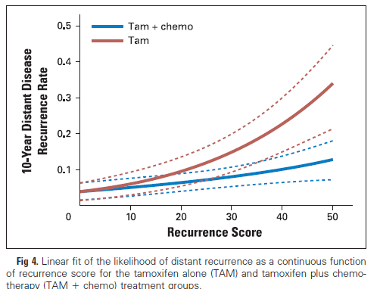

Slide 12
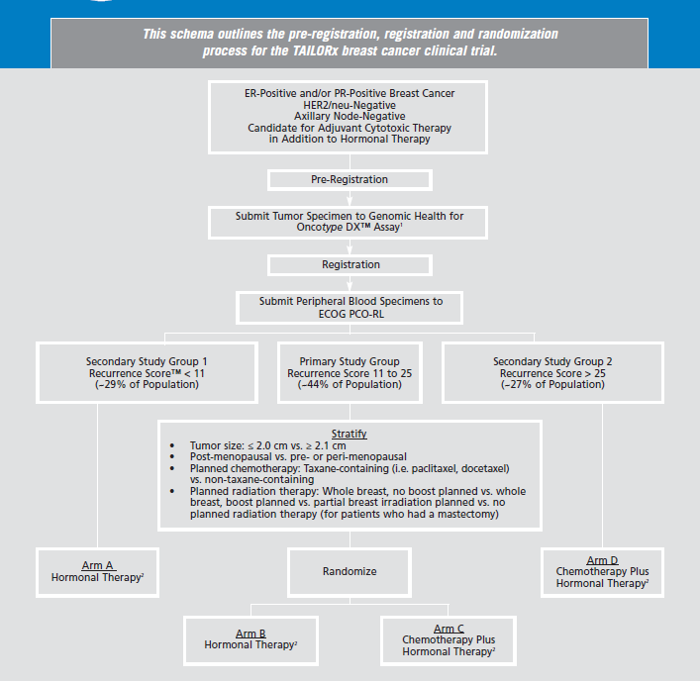

Slide 13
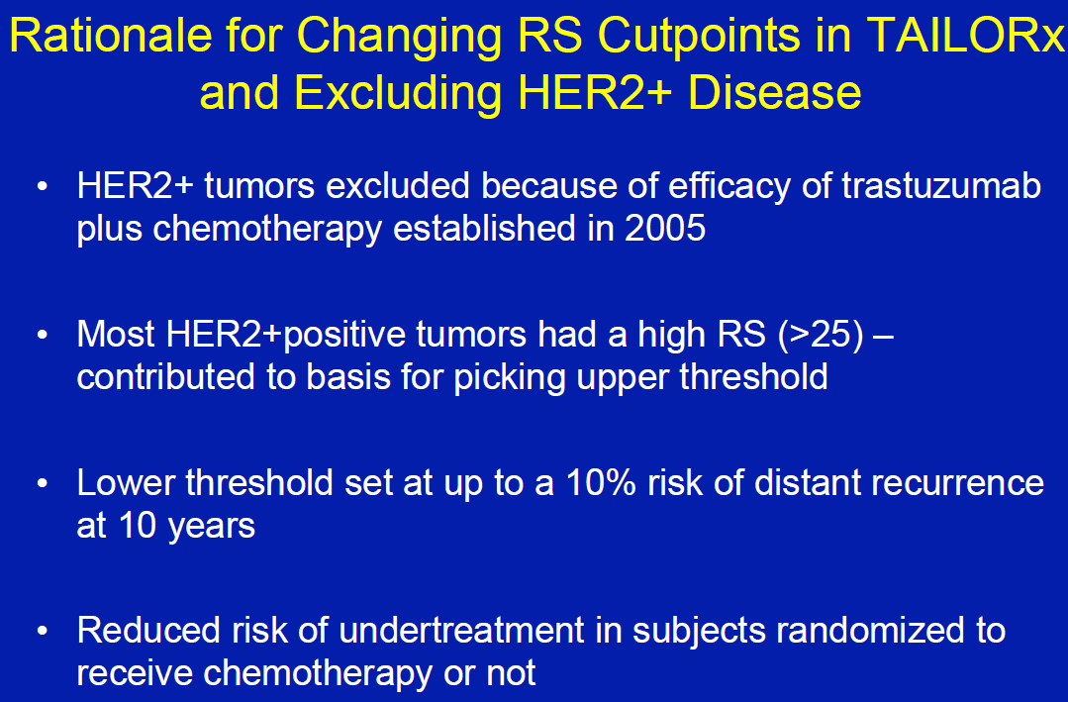
J
Joseph Sparano, TAILORx study chair, Hello Healthcare Summit 2017

Slide 14
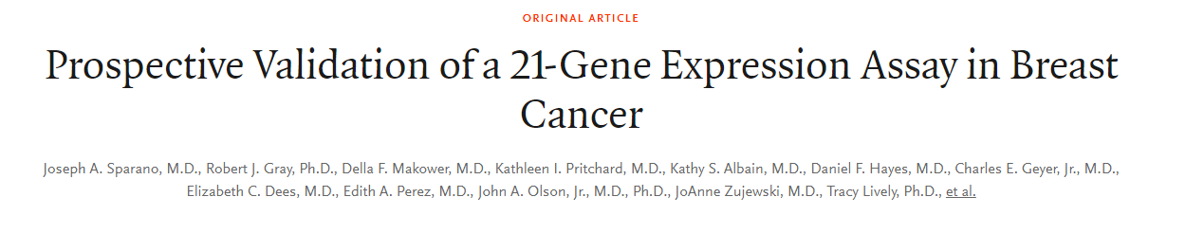
1626 women with recurrence score 0 to 10
5-year DFS: 93.8%
5-year DMFS: 99.3%
5-year OS: 98%
Sparano et al. NEJM 2015

Slide 15
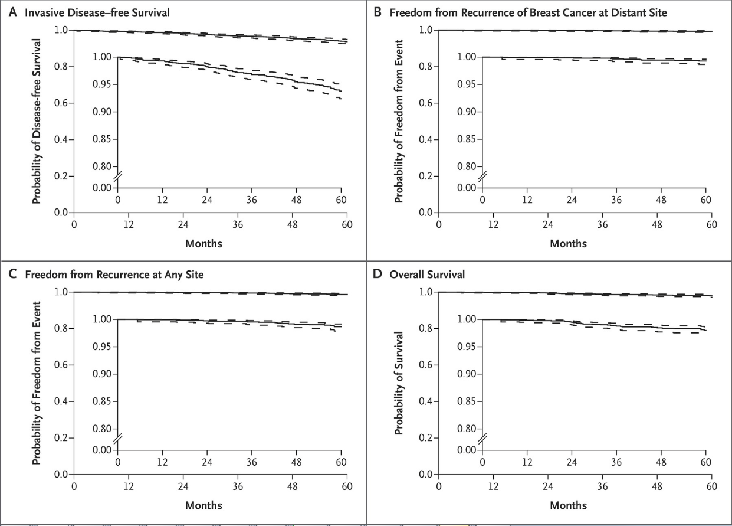

Slide 16
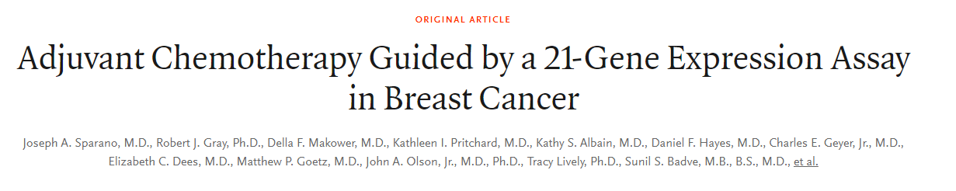
Results of the TAILORx in the intermediate RS (11-25) group
Sparano et al. NEJM 2018

Slide 17
Eligibility criteria
Age 18-75
Hormone receptor positive
HER2 negative
pN0
T1c-T2, or T1b plus high grade or LVSI
No other malignancies within 5 years
No previous DCIS or breast cancer
No SERM or AI for prevention
Meeting lab thresholds for CBC, creatinine, AST

Slide 18
Results
9719 patients, 6711 patients (69%) had int risk
Median followup 90 months

Slide 19
Results
56% received docetaxel-cyclophosphamide and 36% received anthracycline-containing compounds
Median duration endocrine therapy 5.4 years (35% received >5 years)
13% of premenopausal women received ovarian suppression
11.8% nonadherence rate (18.4% in chemo group)

Slide 20
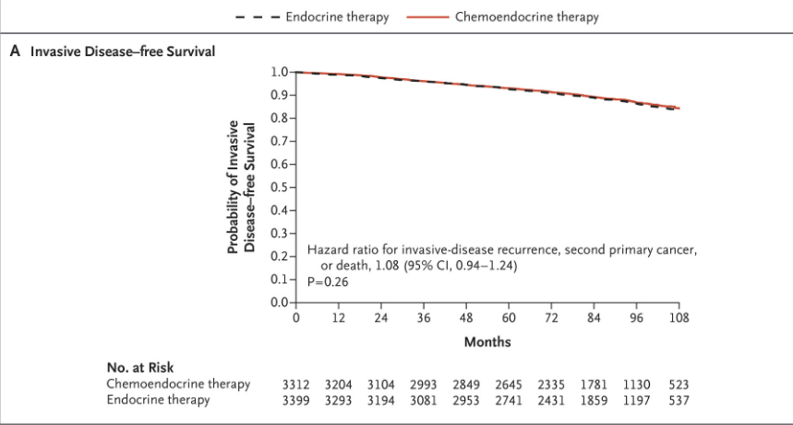
Results

Slide 21
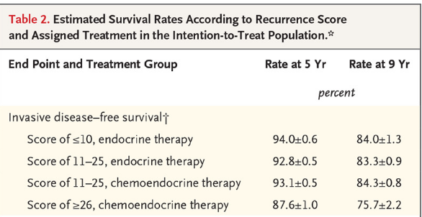

Slide 22
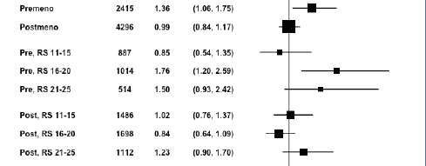
Subgroup analyses
Interactions between chemo and menopausal status

Slide 23
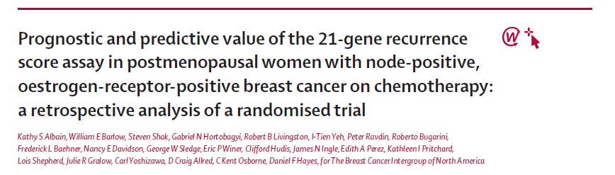
Node-positive
Albain et al. Lancet Oncol 2010

Slide 24
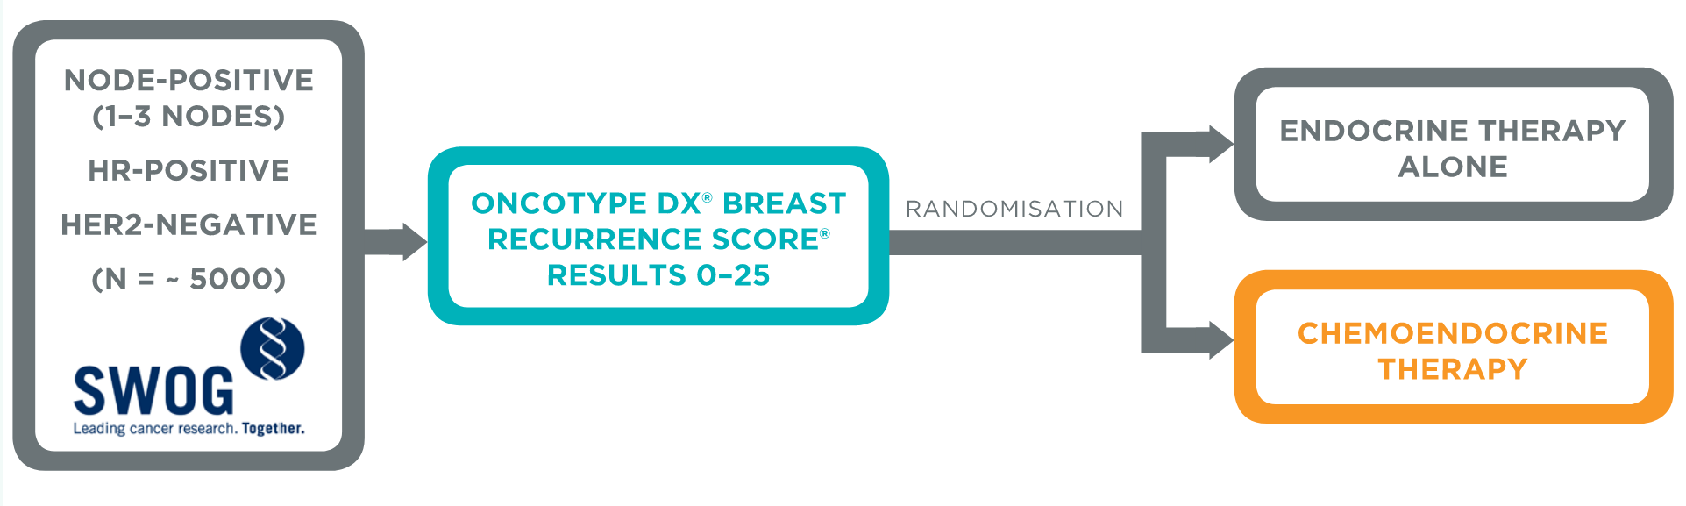
Rxponder

Slide 25
Results
Premenopausal: 5.2% absolute improvement in the iDFS (89.0% vs. 94.2%, HR 0.54, 95% CI [0.38, 0.76]; p = 0.0004) favoring chemotherapy

Slide 26
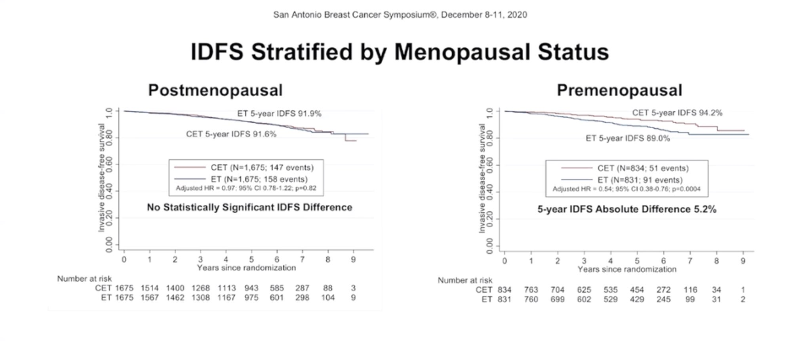

Slide 27
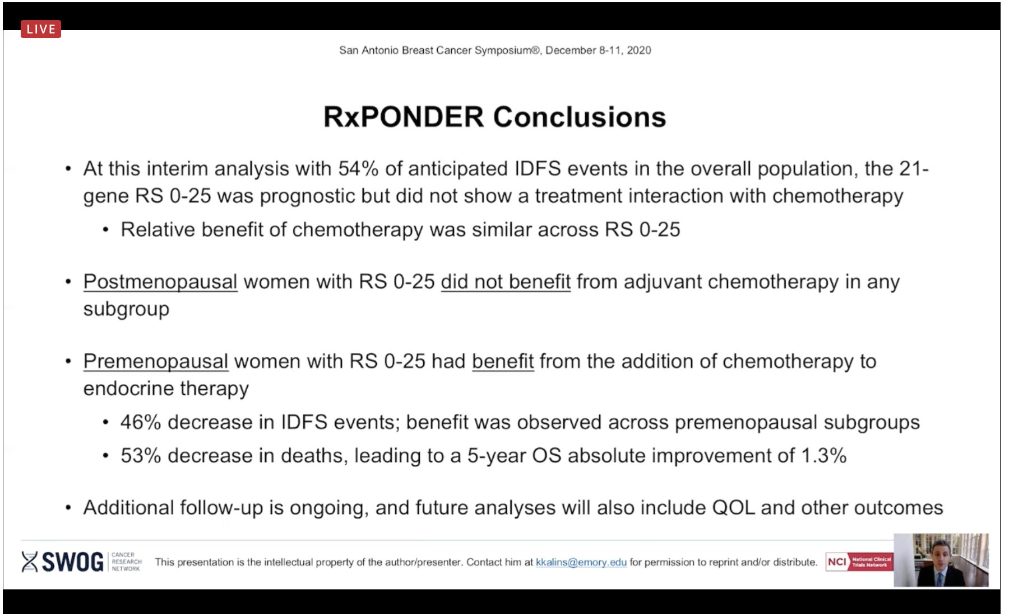

Slide 28
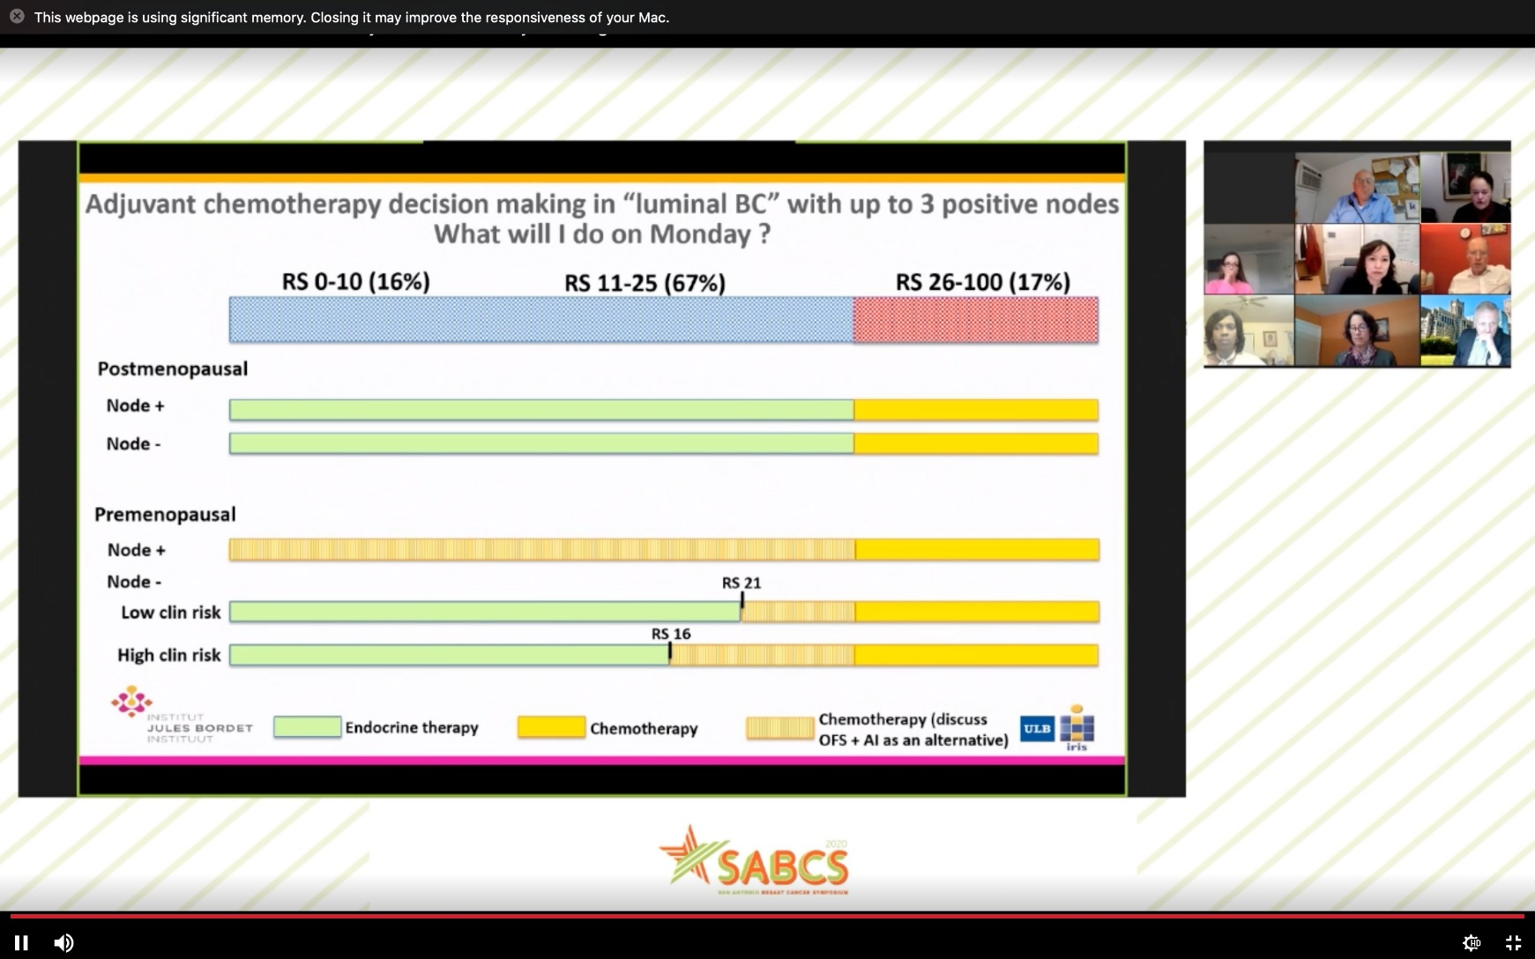

Slide 29
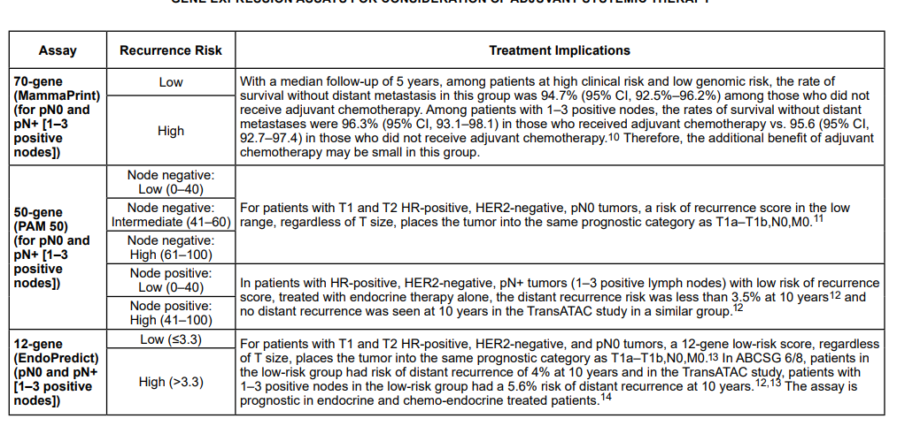

Slide 30
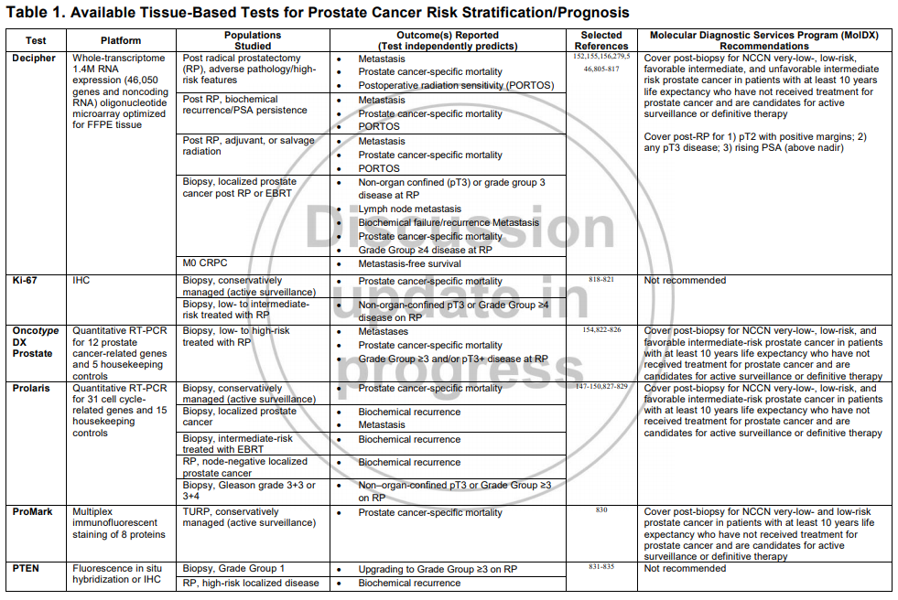
Genomic testing in prostate cancer

Slide 31
Decipher
Genome-wide microarray assay
Uses expression of 22 RNA markers (including both coding and noncoding) to predict DM and PCSM
Originally developed in the post-prostatectomy setting
Gives a score from 0.00 to 1.00 that is divided into low/int/high risk (0-0.45, 0.45-0.6, 0.6-1.0)
Distribution in meta-analysis
Low 60.9% (n = 520), Int 22.6% (n = 193), and High 16.5% (n = 141)

Slide 32
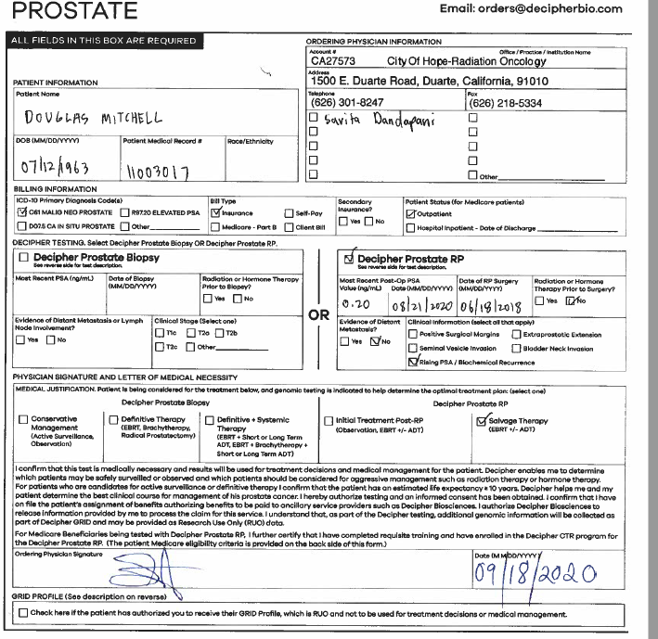

Slide 33
Other practical considerations
Post prostatectomy setting is covered by many/most payors
Testing on biopsy sample coverage more mixed
3 week+ turnaround time
Payment assistance program for patients: max out of pocket cost is $395, income dependent

Slide 34
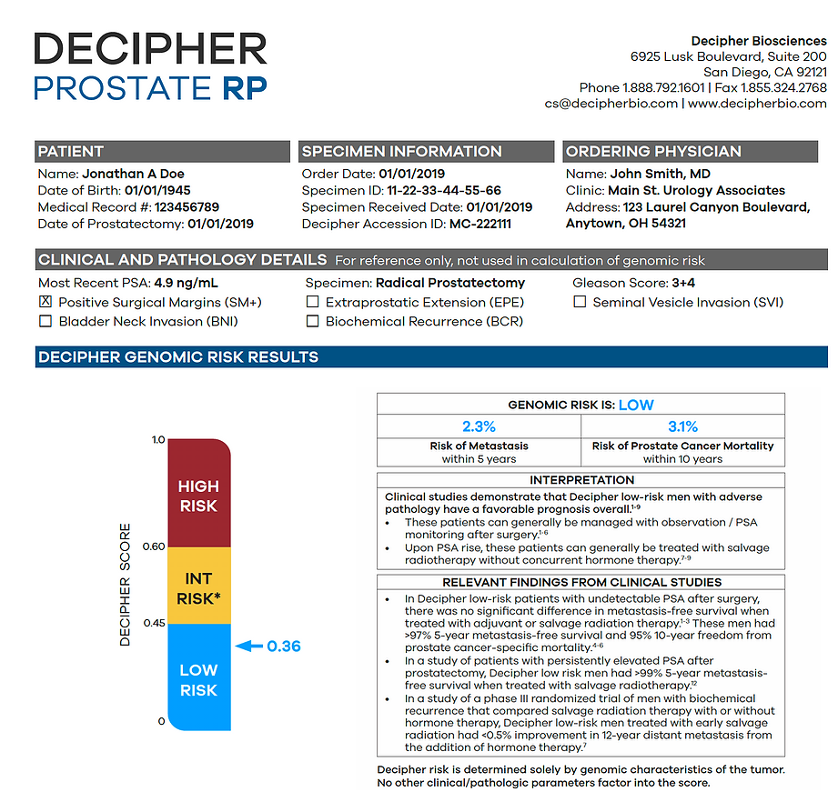
Decipher

Slide 35
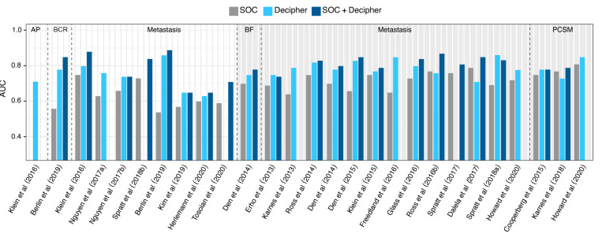

Slide 36
Feng et al. 2021
Post hoc analysis of RTOG 9601
Randomized trial of +/-24 months of bicalutamide with salvage RT demonstrating improved OS
Median PSA of 0.6 ng/mL
Applied decipher testing to post prostatectomy specimens

Slide 37
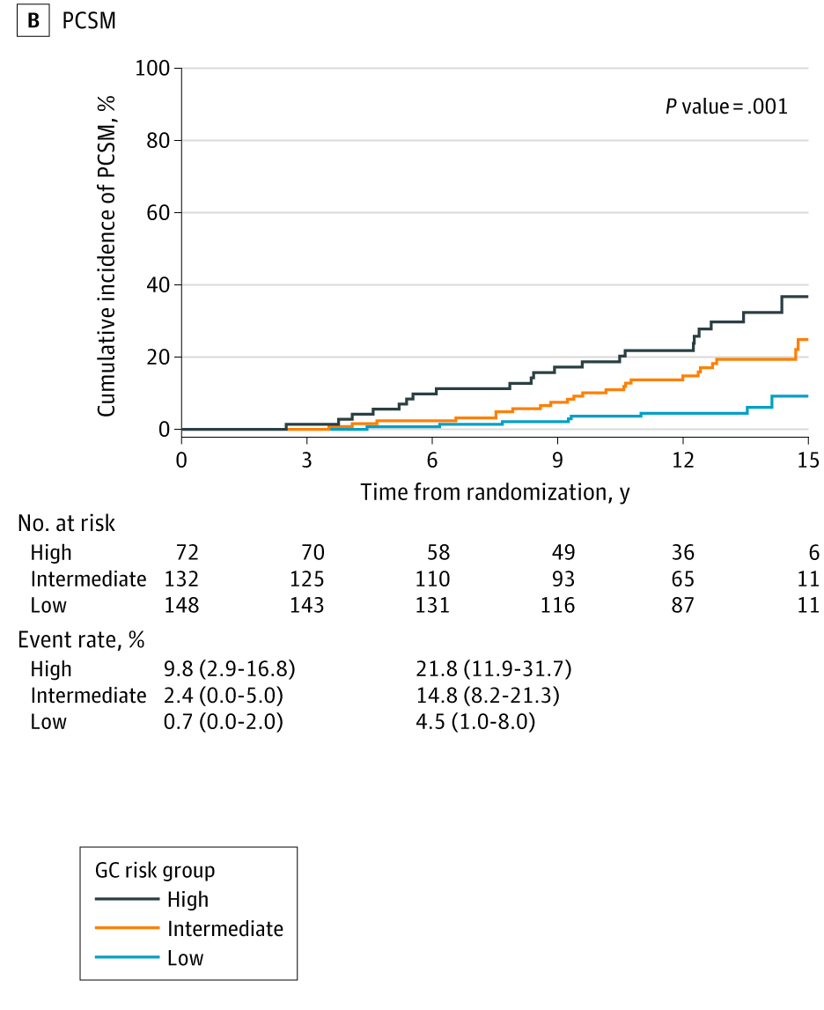
Feng et al. 2021

Slide 38
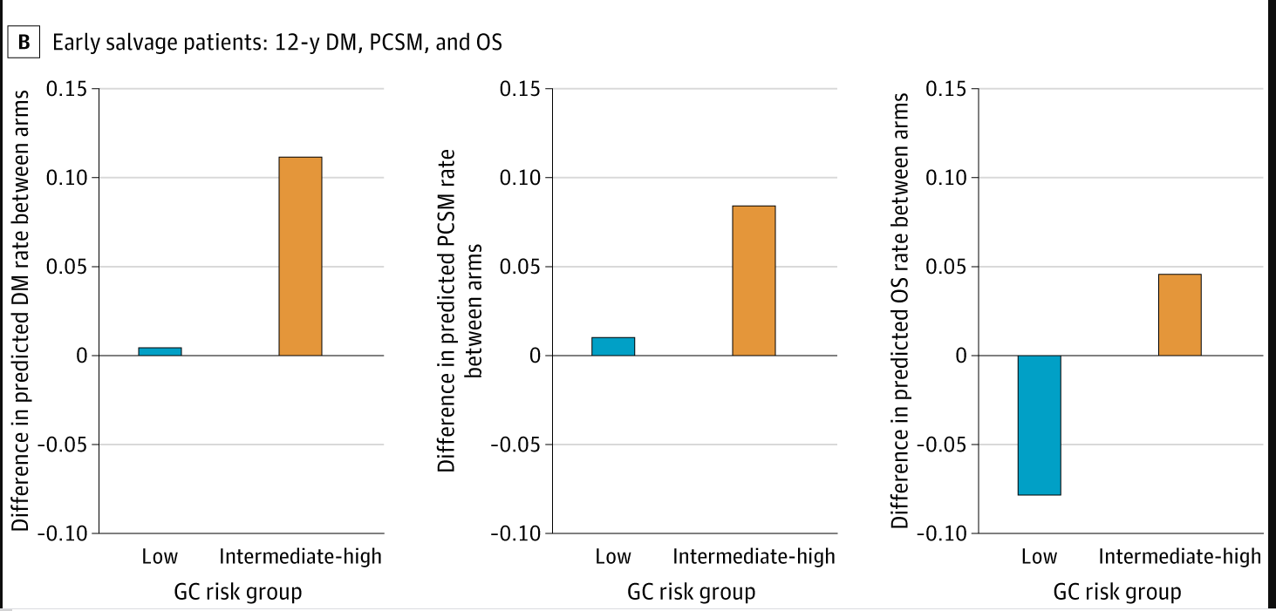

Slide 39
Decipher in post-RP to inform ADT
Best evidence: Post-hoc analysis of RTOG 9601 (Feng et al. JAMA onc 2021)
NCCN says:
Insurance says: mostly covered
My opinion: Reasonable to use. Indication with the strongest evidence. Personally may apply in select cases (borderline PSA)

Slide 40
Decipher in post-RP to inform adjuvant
Best evidence: PRO-IMPACT trial (Gore et al PRO 2019) and supporting registry data
Providers changed treatment recommendation before/after Decipher. 17% of adjuvant and 30% of salvage treatments changed
No difference in 2y PSA recurrence for adjuvant tx in low/int genomic risk
NCCN says:
Insurance says: mostly covered
My opinion: Not that relevant anymore. Just do ES based on RADICALS/RAVES/ARTISTIC

Slide 41
Decipher to inform AS recommendation
Best evidence: Multiple studies showing improved general prognostic accuracy. Prospective registry (Hu et al. JCO 2019) showing increased utilization of AS
NCCN says
Insurance says: experimental
My opinion: Use judiciously in borderline scenarios with shared decision-making with the patient

Slide 42
Decipher to inform definitive treatment intensity
Best evidence: Multiple studies showing improved general prognostic accuracy.
NCCN says:
Insurance says: experimental
My opinion: Would not change treatment intensity based on testing
If patient is highly motivated to have all possible prognostic info, can offer for purely prognostic purposes with likely out of pocket cost

Slide 43
Decipher for metastatic disease
Strong evidence of prognostic value in hormone sensitive prostate cancer: multiple posthoc phase III trial analyses (TITAN, CHAARTED, SPARTAN)
Only in abstract form but indicative that it is prognostic/predictive

Slide 44
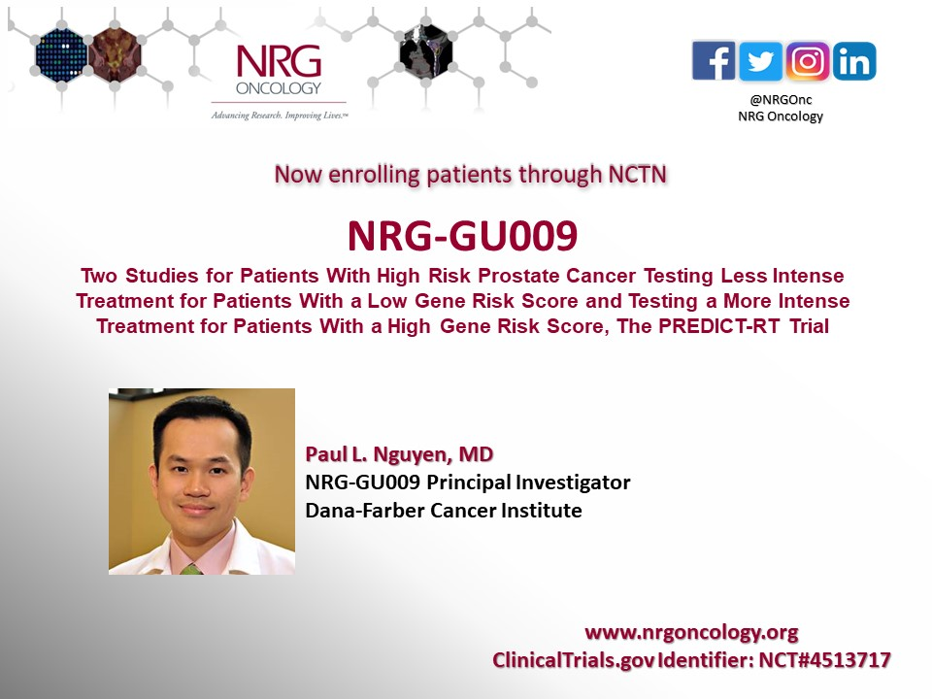
Ongoing trials

Slide 45
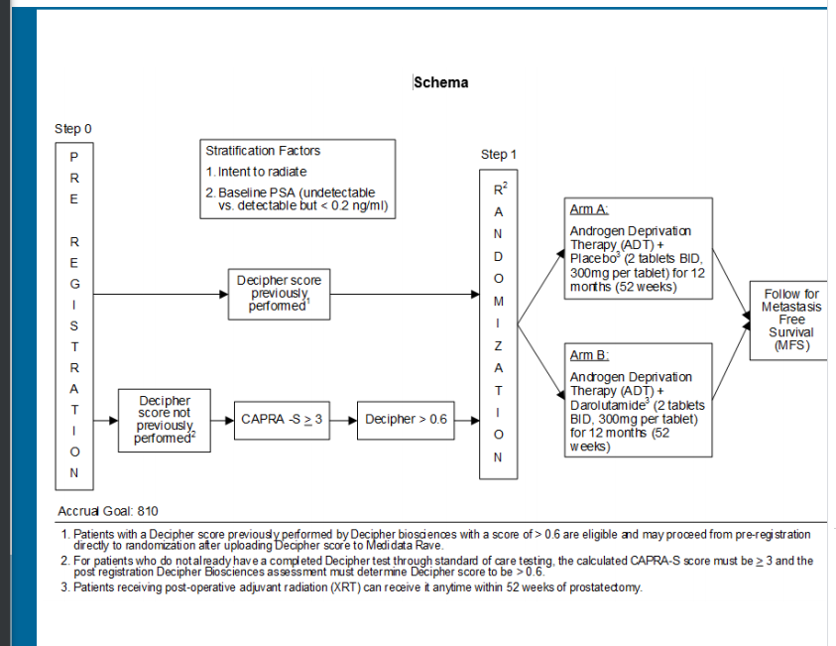
ECOG Eradicate

Slide 46
NRG GU-006
Phase II trial
Salvage RT +/- 6 months of apalatumide
Accrual completed

Slide 47
Summary
Node-negative breast cancer
OncotypeDX is standard
RS <=25 = no chemo, unless premenopausal and borderline RS
Node-positive breast cancer
OncotypeDX standard based on RxPonder
RS <=25 = no chemo in postmenopausal, still consider chemo in premenopausal
Prostate cancer
Reasonable to selectively apply decipher <0.4 in post prostatectomy setting based on posthoc RTOG 9601
Many ongoing trials

